Slide 1
YouTube Song Analysis
With power bi
By Jyoti kumari

Slide 2
Project aim
Analyze YouTube song data using Power Bi for insights on performance, engagement and trends.
Interactive Power BI dashboards showcasing visualizations of YouTube song data trends.
Reports detailing channel and content analysis, temporal trends, and user engagement insights.
Recommendations for content creators and stakeholders to enhance YouTube song video performance.

Slide 3
01 - Problem Statement
02 - Dataset Description
03 - Project Objectives
04 - Power Bi Dashboard
05 - Reports detailing channel and content analysis

Slide 4
01 - Problem Statement
This internship project aims to conduct a comprehensive analysis of YouTube songs data using Power BI. The dataset contains key attributes such as video ID, channel title, title, description, tags, published date, view count, like count, favorite count, comment count, video duration, video definition, and caption details.
The goal is to utilize Power BI to create insightful visualizations and reports that provide a deeper understanding of YouTube songs' performance, popularity, and user engagement. The analysis aims to uncover trends, preferences, and patterns in the data to aid content creators and stakeholders in optimizing their YouTube song content.

Slide 5
02 - Dataset Description
video_id: Unique identifier for each YouTube video.
channelTitle: Title of the YouTube channel publishing the song.
title: Title of the YouTube song video.
description: Description provided for the YouTube song video.
tags: Tags associated with the YouTube song video.
publishedAt: Date and time when the YouTube song video was published.
viewCount: Number of views received by the YouTube song video.
likeCount: Number of likes received by the YouTube song video.
favoriteCount: Number of times the YouTube song video has been marked as a favorite.
commentCount: Number of comments posted on the YouTube song video.
duration: Duration of the YouTube song video.
definition: Video definition or quality (e.g., HD, SD).
caption: Availability of captions for the YouTube song video.

Slide 6
03 - Project Objectives
1. Data Cleaning and Preparation:
-Clean and preprocess the dataset, handling missing values or outliers.
-Convert relevant columns to appropriate data types.
2. Exploratory Data Analysis (EDA):
-Explore patterns and distributions in view counts, like counts, and comments.
- Identify trends in the popularity and engagement of YouTube song videos.
3. Content and Channel Analysis:
- Analyze the distribution of videos across different channels.
- Identify popular tags and their correlation with view counts.

Slide 7
4. Temporal Trends:
- Explore how YouTube song video metrics vary over time.
- Identify peak publishing times and their impact on engagement.
5. User Engagement Insights:
- Investigate relationships between likes, comments, and views.
- Identify factors influencing user engagement with YouTube song videos.

Slide 8
04 & 05 - Power Bi Dashboard Reports detailing channel and content analysis

Slide 9
T-Series Channel Analysis:
230.95bn
ViewCount
2bn
Likes Count
51M
Comment Count

Slide 10
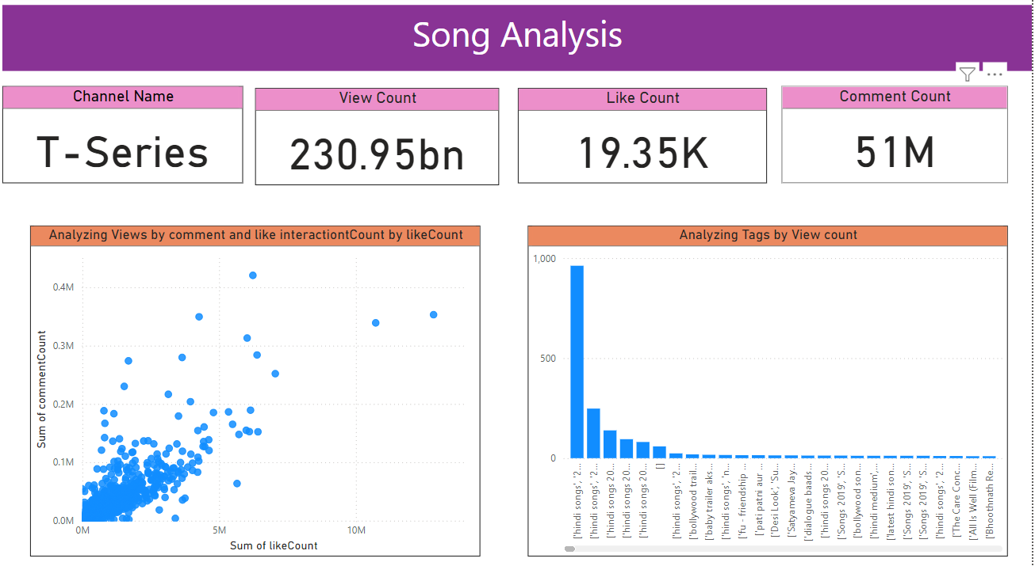

Slide 11
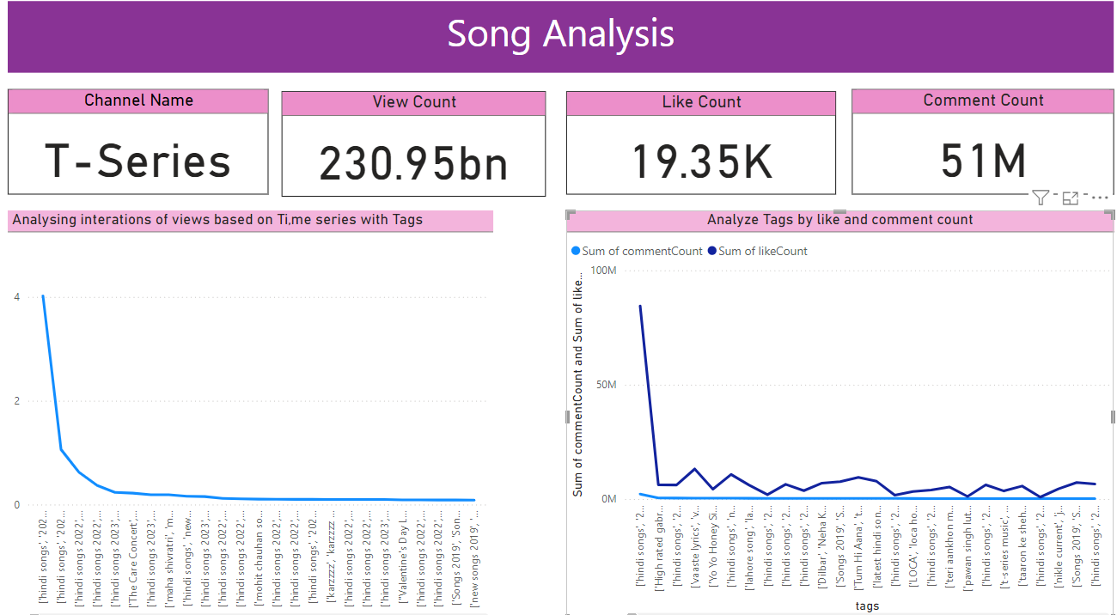

Slide 12
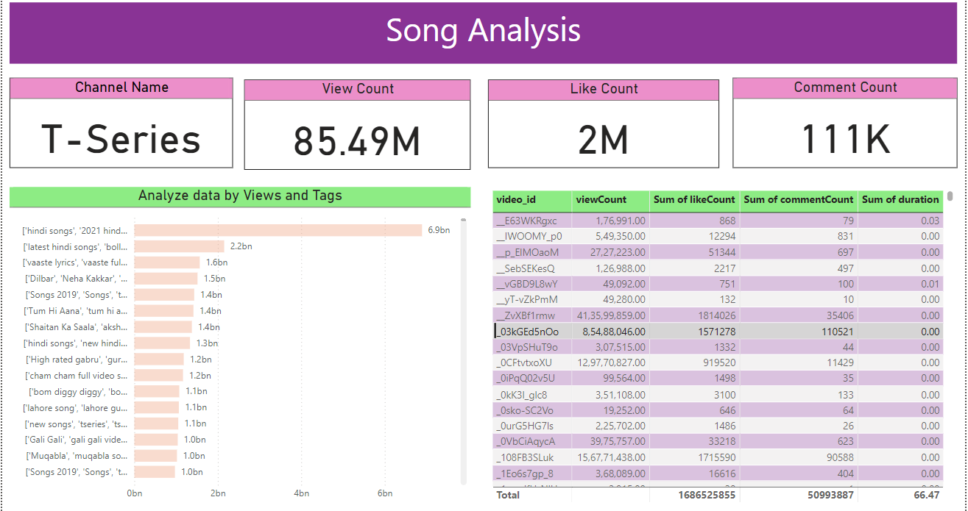

Slide 13
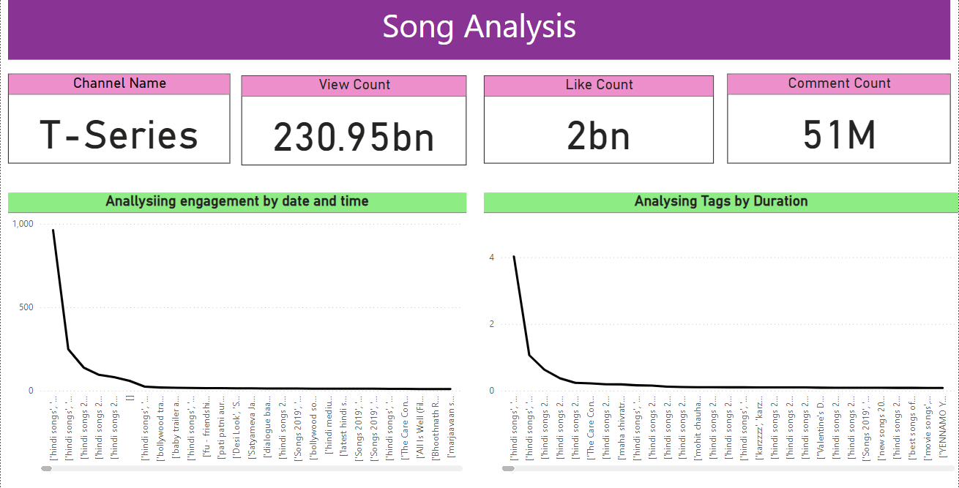

Slide 14
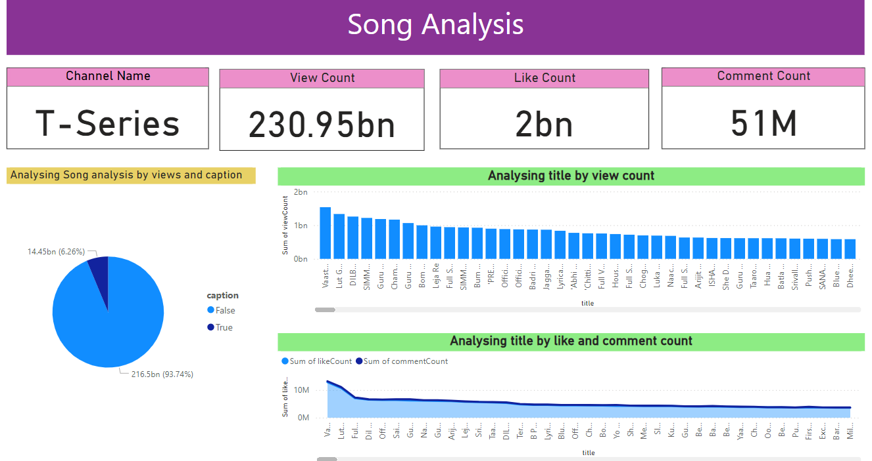

Slide 15
Conclusion
This project provides me hands-on experience in leveraging Power BI for meaningful analysis in the dynamic domain of YouTube Songs, contributing insights to optimize content strategy and engagement.

Slide 16
Thanks!

